Slide 1
Investigation of employee attrition with predictive analytics
Mahesh Kuklani, Rene Pineda and Chaoshun Hu

Slide 2
Outline
Business Objectives
Data Sourced
Methodology
Evaluation/Results
Summary

Slide 3
Business Objectives
The purpose of this analysis is to identify what are the most important factors that contribute to attrition, amongst the many variables that affect an employee’s environment and satisfaction.
Once these factors are determined, a company can take actions to control them, trying to reduce attrition and the costs related to it, such as:
Low employee morale
Operating and monetary costs (severance payments, cost of re-hiring and re-training)
Money invested in the employees that leave the company can't be recovered, their knowledge is lost and can be obtained by competitors.
The decrease in the workforce causes remaining employees to work on the slack left behind- mostly performing the task they are not completely trained to perform or are not the best suited
The situation may get out of control and lead to mass exit of employees, disabling the ability of the company to perform at a high level.

Slide 4
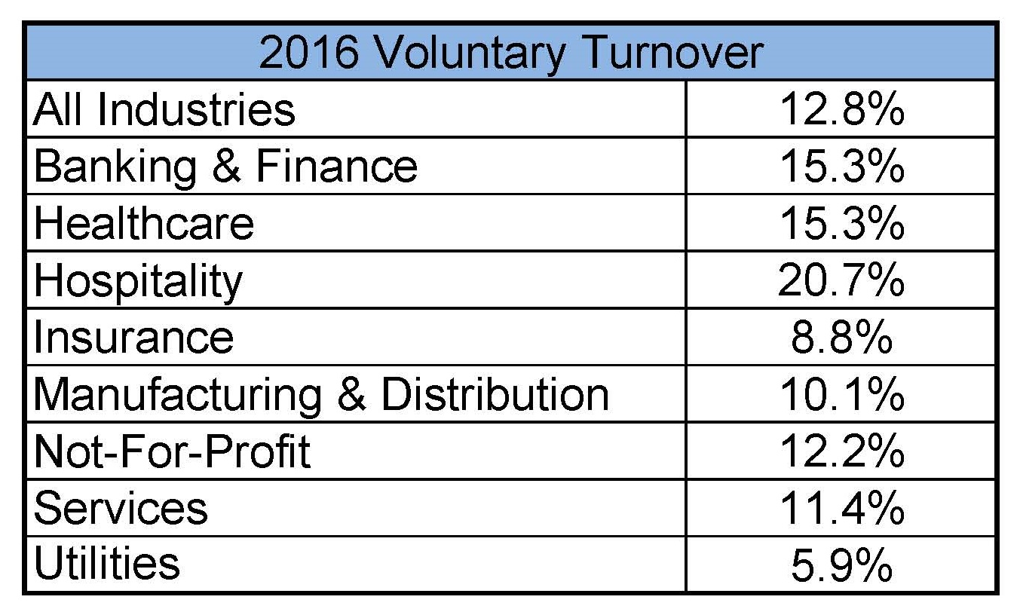
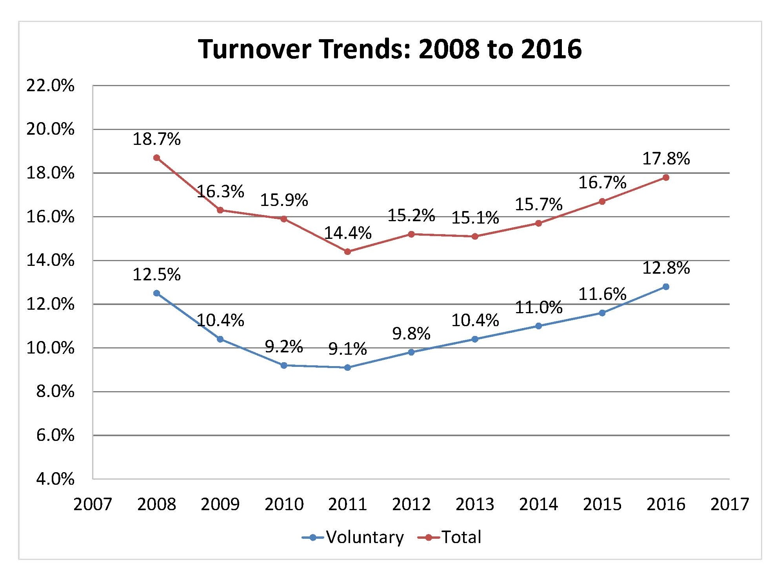
Context: Attrition rates vary significantly across industries and are impacted by internal and external factors
Voluntary attrition occurs when an employee leaves a company of his or her own accord. This can occur when employees leave their current positions for another job, leave the workforce entirely, or retire.
Attrition rates vary widely across industries. Those who work in hospitality, customer service and healthcare experience larger attrition rates, while those that work for utilities or the government show much more stability.
Employee attrition statistics have worsened in recent years, after years of recovery over the recession of 2008. This is due not only to causes within companies, but also to social and economic factors in the job market.
Source: CompData's 2016 edition of their annual BenchmarkPro Survey

Slide 5
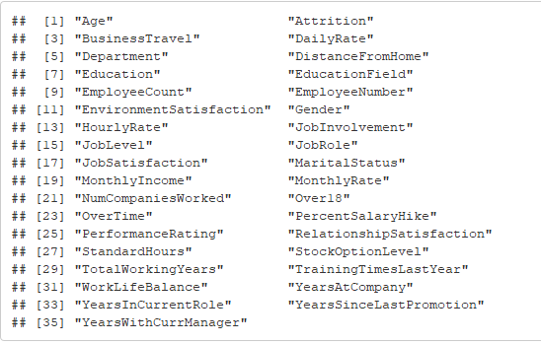
Data Source: Where does the data come from?
We utilized a dataset from “IBM HR Analytics Employee Attrition and Performance”
The dataset has 35 variables, each with 1470 observations
The variables are the following:

Slide 6
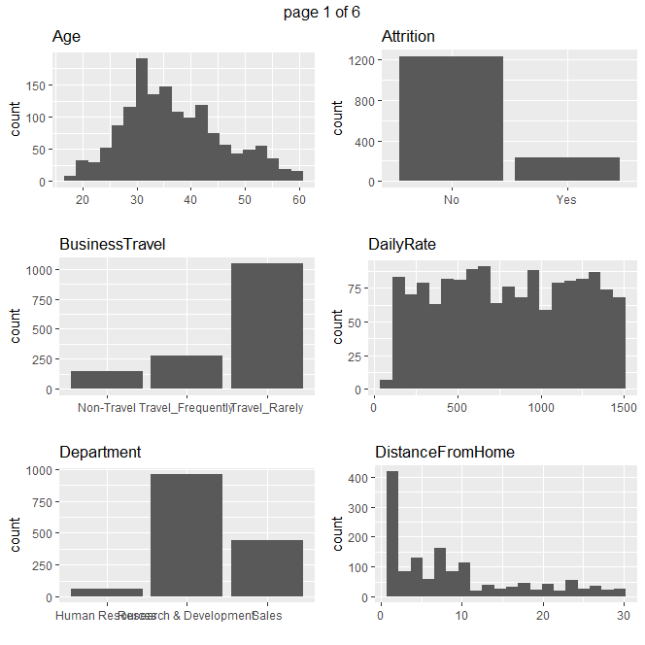
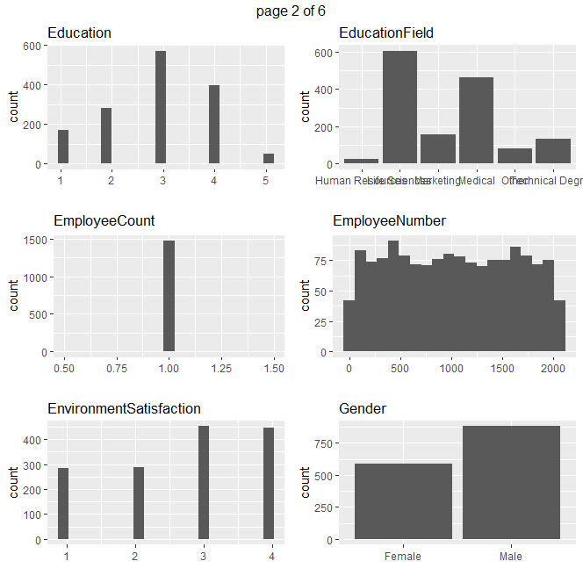
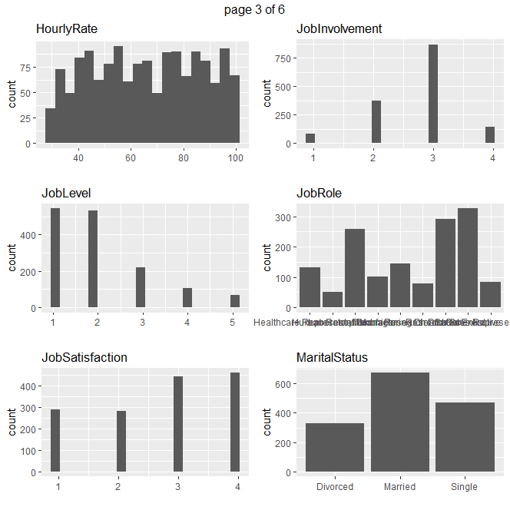
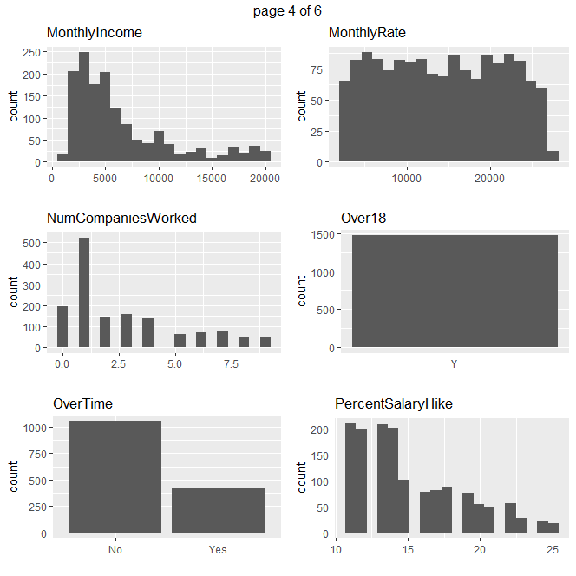
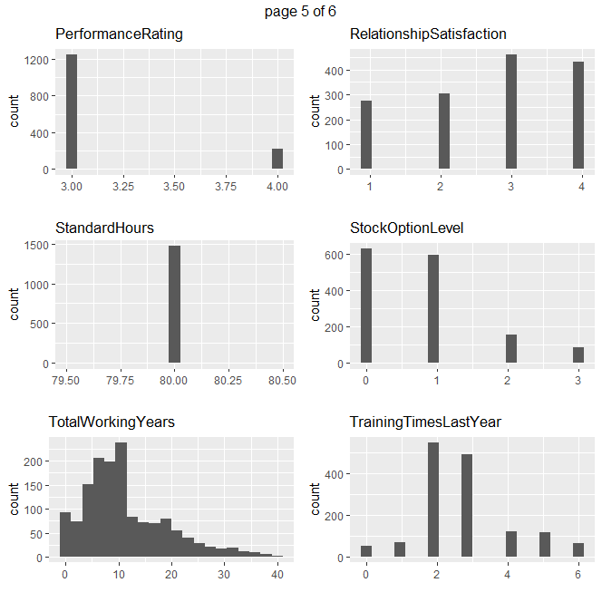
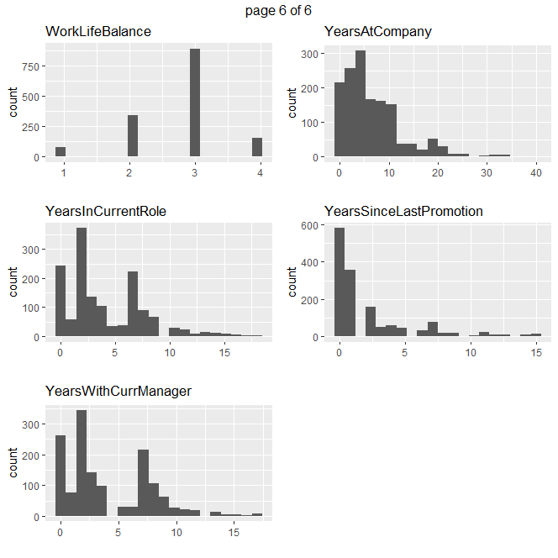
Data Source: Basic Statistics (EDA) 9 categorical variables (factors) and 26 numerical variables No missing observations
Initial exploratory analysis show that some variables might not be useful/relevant because they show the same value or have an almost uniform distribution

Slide 7
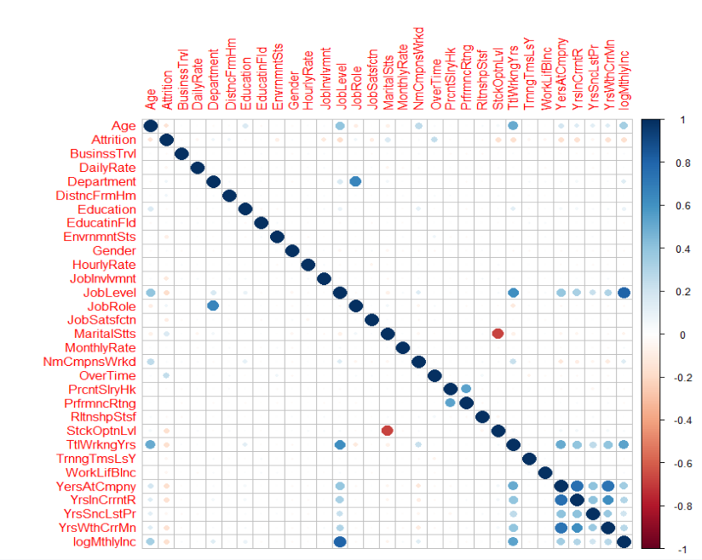
Data Source: Basic Statistics (EDA) As expected, we observe correlations between variables such as age and job level, years at the company and income, and job level and income

Slide 8
Methodology
We propose a 4-step methodology to analyze the data
Steps
Data Preparation
Preliminary Analysis
Evaluation/Results of Exploratory Analysis
Model Using Multivariate Regression
Workflow
Full Model Regression
Forward Model 1
Forward Model 2

Slide 9
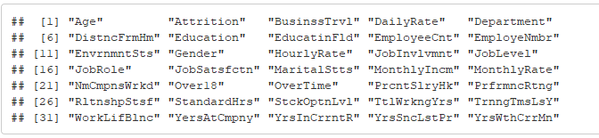
Step 1: Data Cleaning and Preparation Having descriptive, but short variable names is a good practice
Abbreviate column names

Slide 10
Step 1: Data Cleaning and Preparation Several variables have an integer as value, but upon examination they’re really factors. We recoded these variables
Recode Variables from ‘numeric’ to ‘factor’
Original variable as numeric | Recoded variable as factor
Education, 1 to 5 | 1 'Below College' 2 'College' 3 'Bachelor' 4 'Master' 5 'Doctor'
EnvironmentSatisfaction, 1 to 4 | 1 'Low' 2 'Medium' 3 'High' 4 'Very High'
JobInvolvement, 1 to 4 | 1 'Low' 2 'Medium' 3 'High' 4 'Very High'
JobSatisfaction, 1 to 4 | 1 'Low' 2 'Medium' 3 'High' 4 'Very High'
PerformanceRating, 1 to 4 | 1 'Low' 2 'Good' 3 'Excellent' 4 'Outstanding'
RelationshipSatisfaction , 1 to 4 | 1 'Low' 2 'Medium' 3 'High' 4 'Very High'
WorkLifeBalance, 1 to 4 | 1 'Bad' 2 'Good' 3 'Better' 4 'Best'
JobLevel, 1 to 5 | Ordered factor, with 5 been the highest level

Slide 11
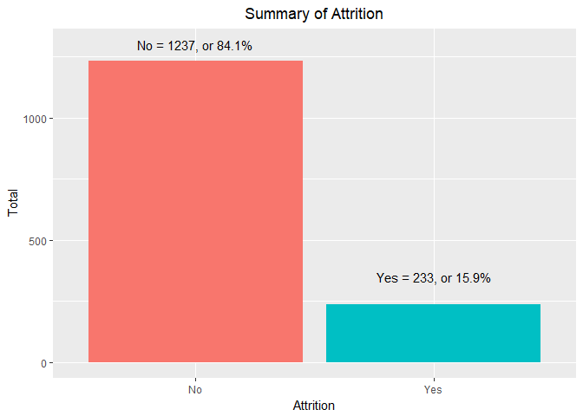
Step 2: Preliminary Analysis First of all, we examine the proportion of attrition in the data: 15.9% of employees left the company

Slide 12
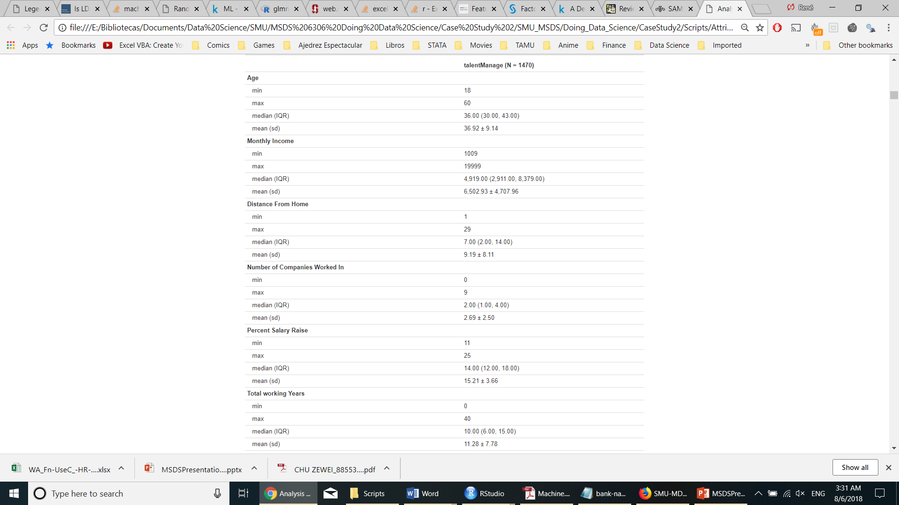

Step 2: Preliminary Analysis We analyze summary statistics of numerical variables: max, min, median, mean and std. deviation

Slide 13
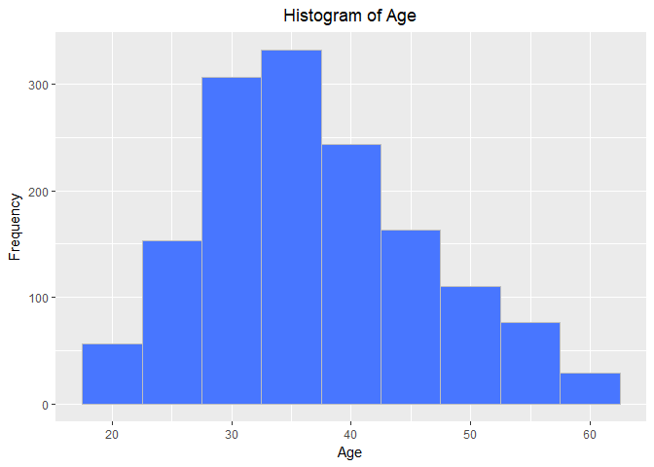
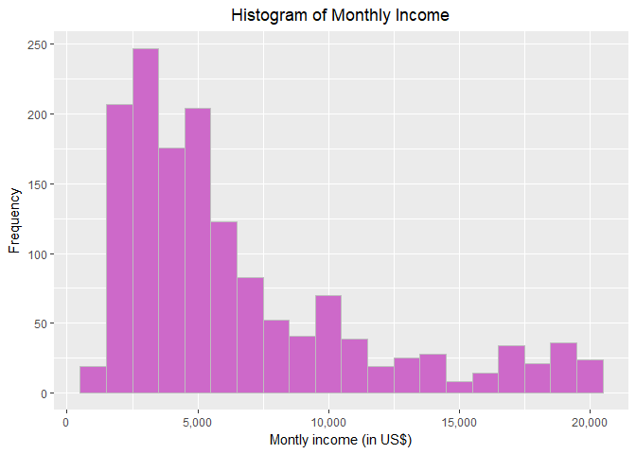
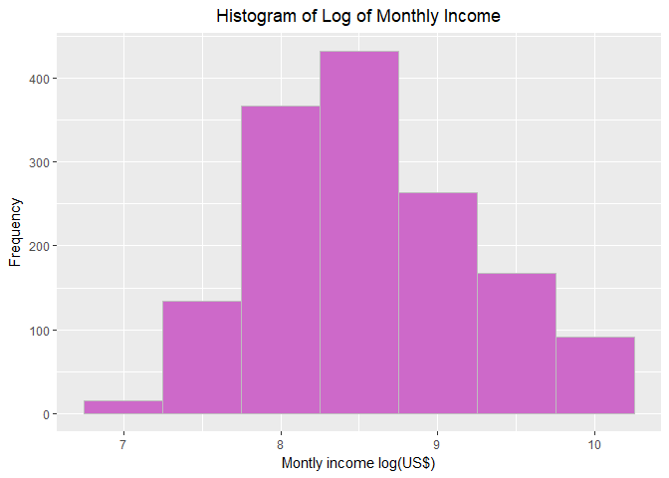
Step 2: Preliminary Analysis Histograms are very useful to analyze the distribution of numerical variables
The Age variable is centered around 36.92 years. It shows a slight positive skewness.
The Monthly Income shows a very strong positive skewness: there is a few employees that earn very high salaries. Doing a log transformation of this variable will help reducing the influence of extreme values.

Slide 14
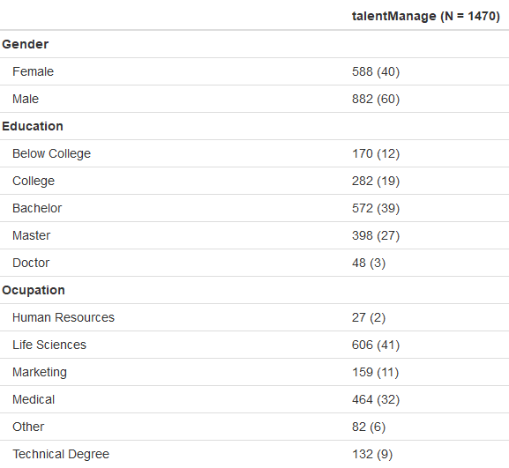
Step 2: Preliminary Analysis Tables of frequencies and proportions help us analyze categorical data

Slide 15
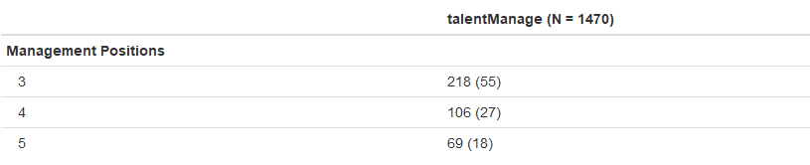
Step 2: Preliminary Analysis It isn’t always so clear-cut. We need to examine data closely to perform certain tasks
Question: Which Job Roles correspond to managerial positions?
Answer: examine a small subset of observations of job roles and levels:
[1] "Laboratory Technician,1" "Healthcare Representative,3" "Laboratory Technician,2"
[4] "Manager,4" "Laboratory Technician,1" "Research Scientist,2"
[7] "Sales Executive,3" "Manager,3" "Sales Executive,3"
[10] "Laboratory Technician,1" "Manager,4" "Research Scientist,1"
[13] "Sales Executive,2" "Research Scientist,1" "Research Director,5"
[16] "Sales Executive,2"
Conclusion: We’ll define managerial positions as those with Job Level 3 and above

Slide 16
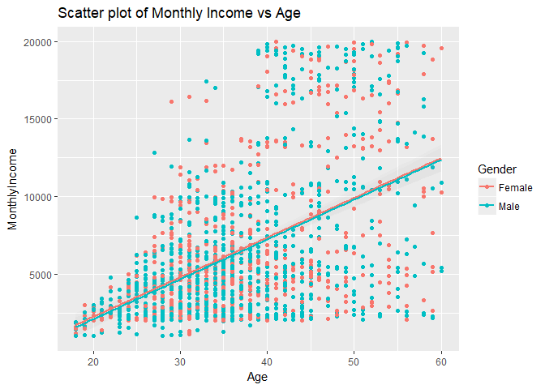
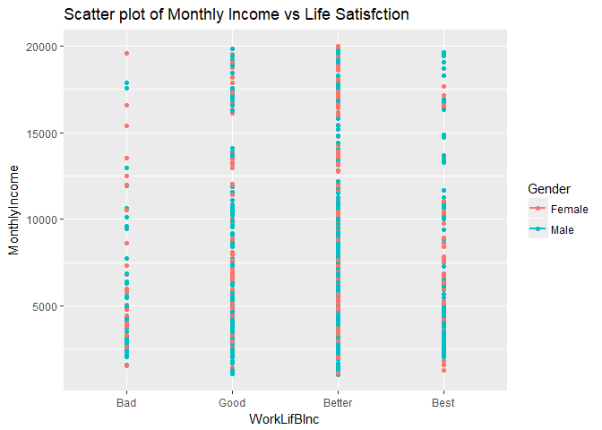
Step 3: Evaluation/Results Is there a relationship between age and income? What about Life satisfaction?
There is a very strong linear relationship between age and income, explained by the fact that older employees have higher job levels or tenure-related salary increases.
There seems to be overall salary equality for males and females, although we haven’t inspected equality controlling by job role or level.
There is not a strong relationship between income and life satisfaction (measured by work/life balance).
The distributions of income by the different levels of satisfaction look similar.

Slide 17
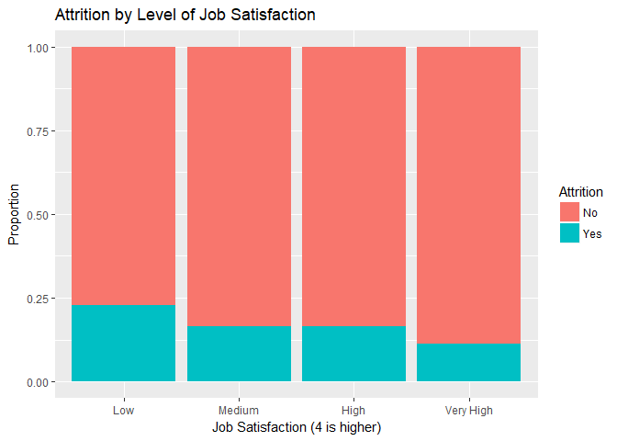
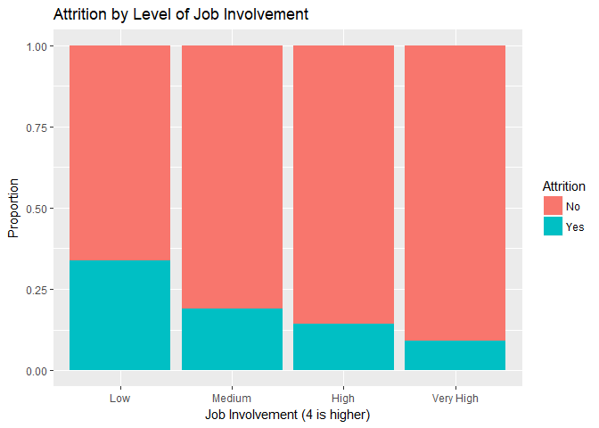
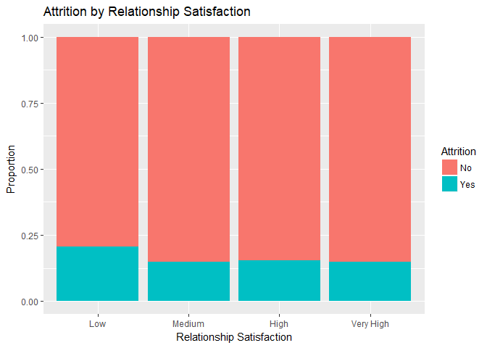
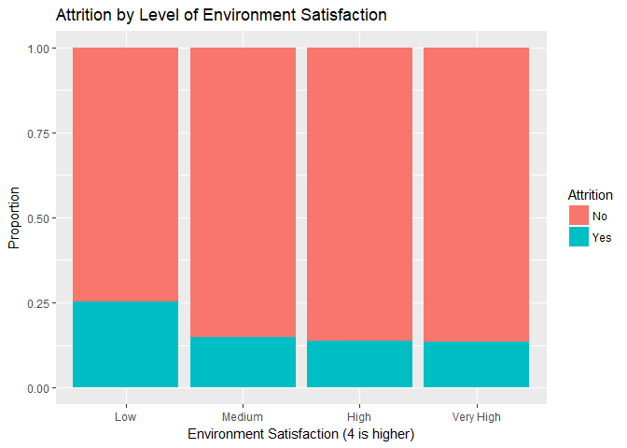
Step 3: Evaluation/Results Which variables are associated with higher attrition?
As expected, lower satisfaction and involvement in the job leads to higher attrition rates. Employees that rank their satisfaction as ‘1’ are the highest concern.

Slide 18
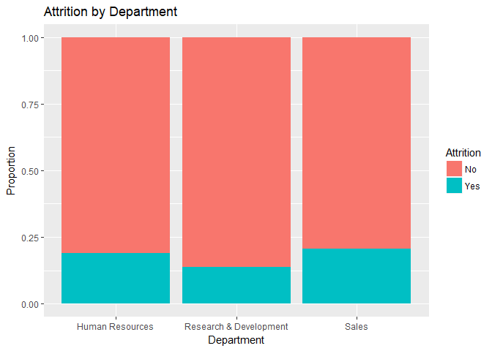
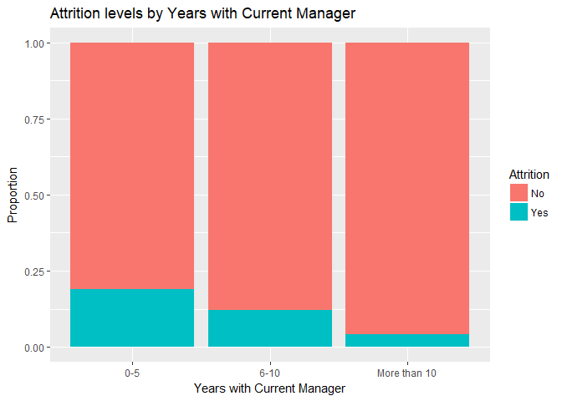
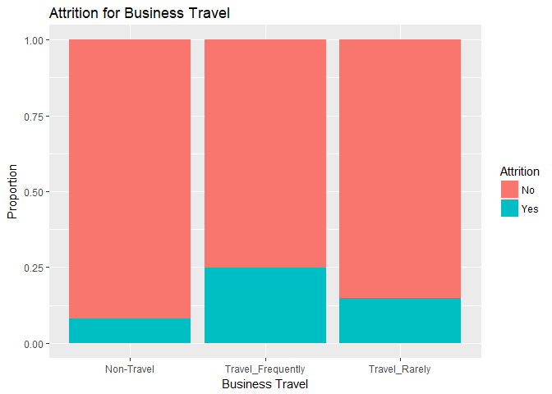
Step 3: Evaluation/Results Which variables are associated with higher attrition?
Employees that travel more have higher attrition. Likewise, employees that have spent less time with the same manager have higher attrition (age/role/salary might be confounding variables here).
There are some differences in attrition by department, albeit they’re smaller than in other factors.

Slide 19
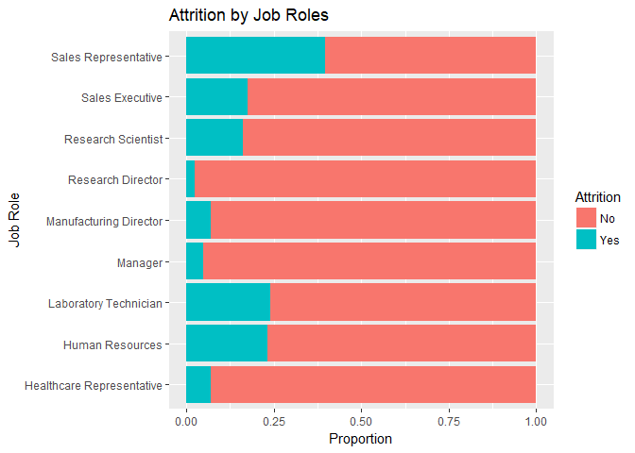
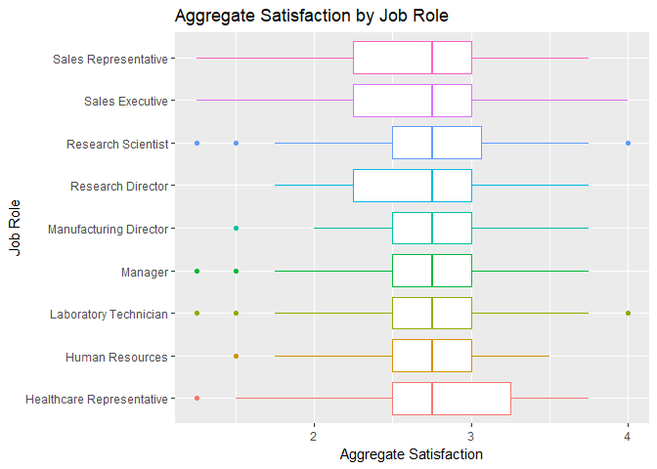
Step 3: Evaluation/Results Job role specific trends
There are clear differences in attrition by job roles. Sales representatives and executives have high attrition, the same as research scientists and laboratory technicians.
Directors and Managers have very low levels of attrition.
These differences are not completely explained by satisfaction at the job. Median satisfaction is very similar for all roles.
There are some roles, however, where the distribution has a larger variance and is skewed to the right, indicating a larger proportion of people with very low levels of satisfaction.

Slide 20
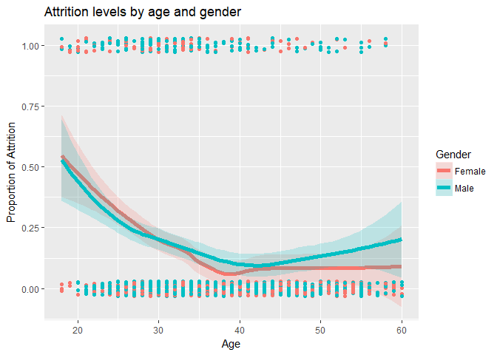
Step 3: Evaluation/Results, Other interesting trends How are age and gender related to Attrition?
There is a clear pattern where attrition steadily decreases as age increases, until employees reach ages 35-45. After that, attrition increases again.
Younger people are clearly more prone to attrition than older people.
There is no difference between sexes (confidence intervals overlap)

Slide 21
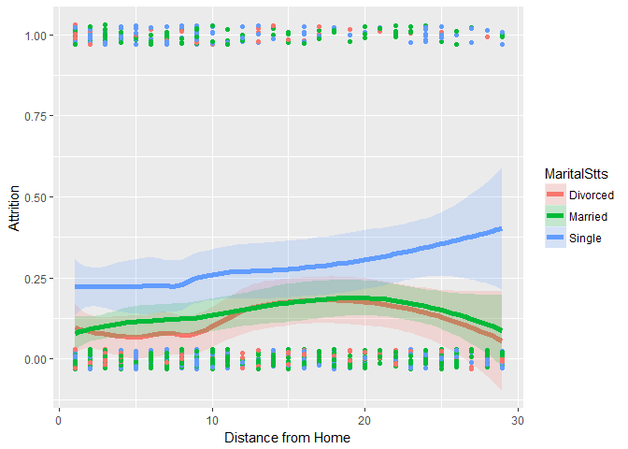
Step 3: Evaluation/Results, Other interesting trends Do distance from home and marital status affect attrition?
When single people live far from their workplace, their attrition increases. It is likely that age/position/salary are confounding variables for single people.
Married/divorced people show very similar behaviors, with attrition decreasing after certain distance. Many hypothesis about preferences for urban/suburban areas, responsibilities, kids and family can be formulated from this chart.

Slide 22
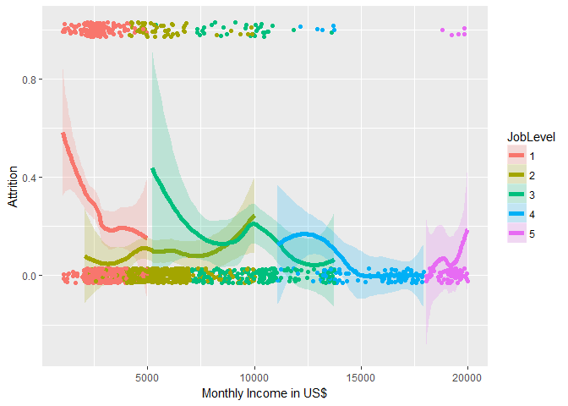
Step 3: Evaluation/Results, Other interesting trends How do salaries and job levels affect attrition?
Large variation of salaries within job levels. For entry-level level-4 jobs, higher salary = lower attrition. Level 5 are the most senior executives, attrition is probably influenced by retirement
Level 2 and level 3 jobs are interesting profiles: aspiring managers, mid-level managers that are advancing their careers, might grow dissatisfied and decide to leave when they feel they hit a ceiling in the company, or decide to stay if they reach the next tier

Slide 23
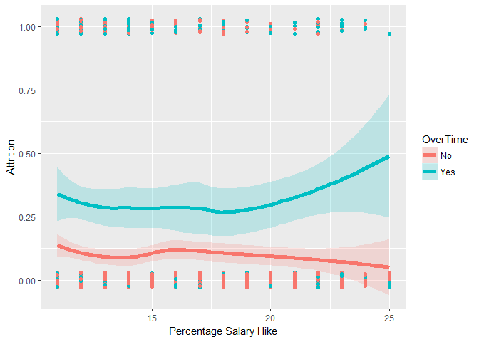
Step 3: Evaluation/Results, Other interesting trends Salary increases and overtime
Employees that work overtime have distinctly higher attrition rates than those who don’t. Even large salary increases don’t seem to compensate for working long hours!

Slide 24
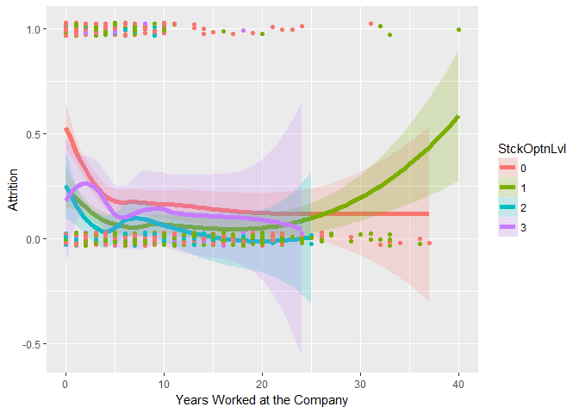
Step 3: Evaluation/Results, Other interesting trends Are stock options an effective mechanism to reduce attrition?
Many companies offer stock options to incentive employees to stay in the company until they are “fully vested” and able to exercise the option (3-10 years)
This seems to be effective for those who receive the options, although it doesn’t do anything for those employees that are systematically left out of the options (likely younger, lower-level employees)

Slide 25
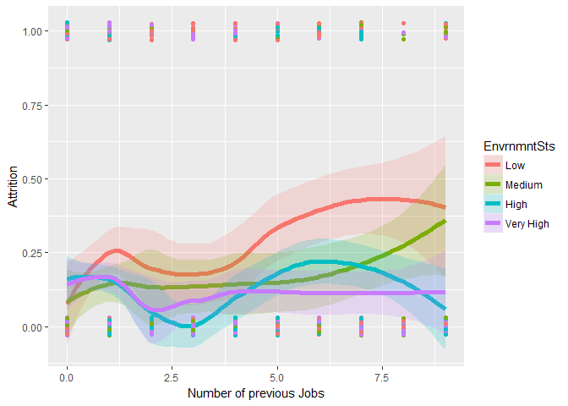
Step 3: Evaluation/Results, Other interesting trends Are there people intrinsically more prone to change jobs frequently?
For people who have had more than five previous jobs, and that have low or medium levels of satisfaction, attrition rates start to climb very rapidly.
People who had many previous jobs seem to be more prone to be dissatisfied at their current job.
People who have had many previous jobs, but are currently satisfied or very satisfied, have very low attrition rates.

Slide 26
Step 4: Logistic model for prediction
Transformation of Parameters:
Education
“1” is reference i.e. Basic College, “2” is College, “3” is bachelor, “4” is Master and “5” is Doctor
Environment Satisfaction, Job Involvement and Job Satisfaction
“1” is reference i.e. “Low”, “2” is Medium, “3” is High and “4” is Very High
Performance Rating
“1” is reference i.e. “Low”, “2” is Good, “3” is Excellent and “4” is Outstanding
Work Life Balance
“1” is reference i.e. Bad, “2” is Good, “3” is better and “4” is Best
Job Level and Training times last year
Converted to factor with value “1” as reference
Stock Option Level
Converted to factor with 0 as reference.

Slide 27
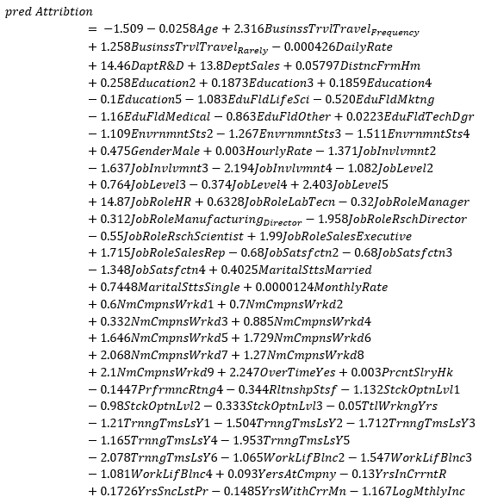
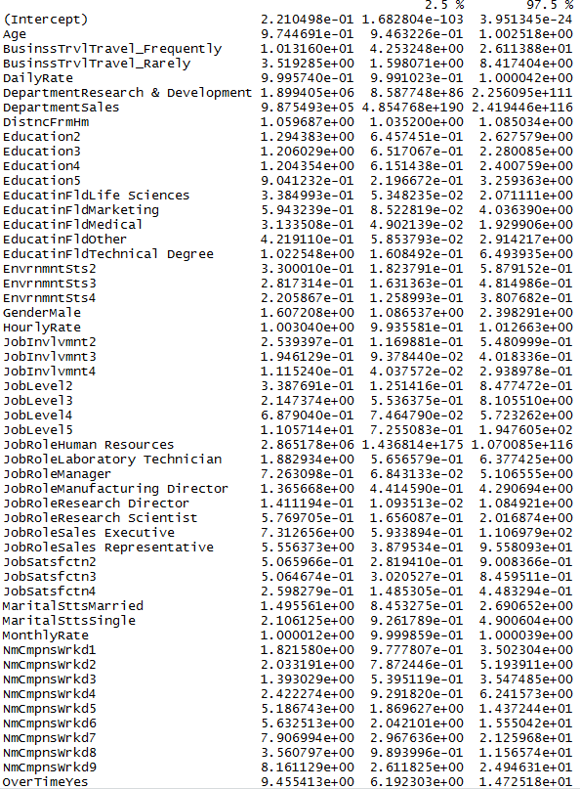
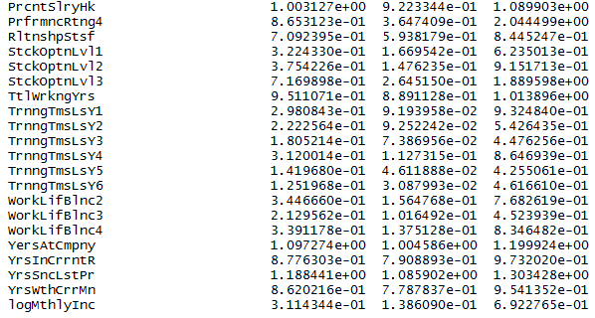
Full Model : Fit equation and 95% C.I.
……

Slide 28
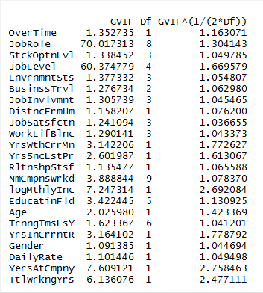
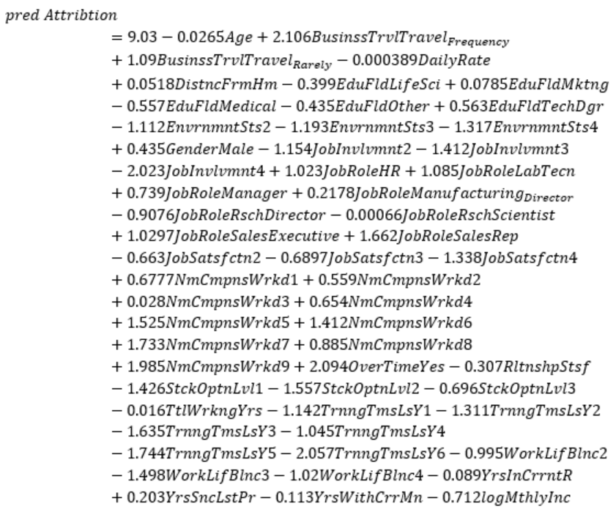
Forward Selection – Fit equation and VIF
JobLevel and JobRole are highly correlated
28

Slide 29
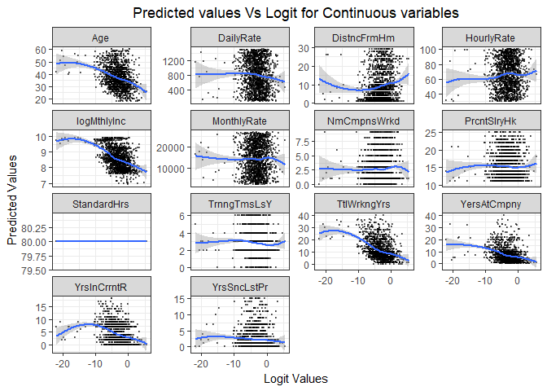
Visual Inspection of Continuous Variables
Predicted values Vs Logit graphs for the continuous variables.
We see most of the continuous variables are linearly correlated other than Distance from home, Years in current role and standard hours.

Slide 30
Forward Selection: Fit for Forward 2 model w/o Job Level
Pred(Attrition| OverTimeNo, JobRoleHealthcare_Representative, StckOptnLvl0, EnvrnmntSts1, BusinssTrvlNon_Travel, JobInvolvmnt1, JobSatsfctn1, NmCmpnsWrkd0, WorkLifBlnc1, EducatinFldHuman_Resources, TrnngTmsLsY0, GenderFemale) = 9.029 + 2.094OverTimeYes + 1.023 JobRoleHumanServices + 1.085 JobRoleLaboratory_Technician + 0.739 JobRoleManager + 0.218 JobRoleManufacturing_Director + (-0.907) JobRoleResearch_Director + (-0.0006) JobRoleResearch_Scientist + 1.03 JobRoleSales_Executive + 1.661 JobRoleSales_Representative + (-1.426) StckOptnLvl1 + (-1.557) StckOptnLvl2 + (-0.696) StkOptnLvl3 + (-1.111) EnvrnmntSts2 + (-1.193) EnvrnmtSts3 + (-1.317) EnvrnmtSts4 + 2.106 BusinssTrvlTravel_Frequently + 1.090 BusinssTrvlTravel_Rarely + (-1.154) JobInvlvmnt2 + (-1.412 JobInvlvmnt3 + (-2.023) JobInvlvmnt4 + 0.051 DistncFrmHm + (-0.663) JobSatsfctn2 + (-0.69) JobSatsfctn3 + (-1.338) JobSatsfctn4 + 0.678 NmCmpnsWrkd1 + 0.56 NmCmpnsWrkd2 + 0.028 NmCmpnsWrkd3 + 0.654 NmCmpnsWrkd4 + 1.525 NmCmpnsWrkd5 + 1.412 NmCmpnsWrkd6 + 1.733 NmCmpnsWrkd7 + 0.884 NmCmpnsWrkd8 + 1.985 NmCmpnsWrkd9 + (-0.016) TtlWrkngYrs + (-0.995) WorkLifBlnc2 + (-1.498) WorkLifBlnc3 + (-1.02) WorkLifBlnc4 + (-0.307) RltnshpStsf + 0.203 YrsSncLstPr + (-0.712) logMthlyInc + (-0.089) YrsInCrrntR + (-0.399) EducatinFldLife Sciences + 0.079 EducatinFldMarketing + (-0.557) EducatinFldMedical + (-0.435) EducatinFldOther + (-0.563) EducatinFldTechnical Degree + (-1.142) TrnngTmsLsY1 + (-1.311) TrnngTmsLsY2 + (-.1.635) TrnngTmsLsY3 + (-1.045) TrnngTmsLsY4 + (-1.744) TrnngTmsLsY5 + (-2.057) TrnngTmsLsY6 + (0.435) GenderMale + (-0.113) YrsWthCrrMn + (-0.0004) DailyRate + (-0.0266) Age
This equation interpretation is as below
If an employee did an Overtime vs no overtime for every one using increase in overtime the odds of the person staying with the company is 2.094, keeping all other variables constant.
If an employee is in Human Services Job Role vs Healthcare job role for every unit increase in Human services job the odds of person not leaving the company is 1.023, keeping all other variables constant.

Slide 31
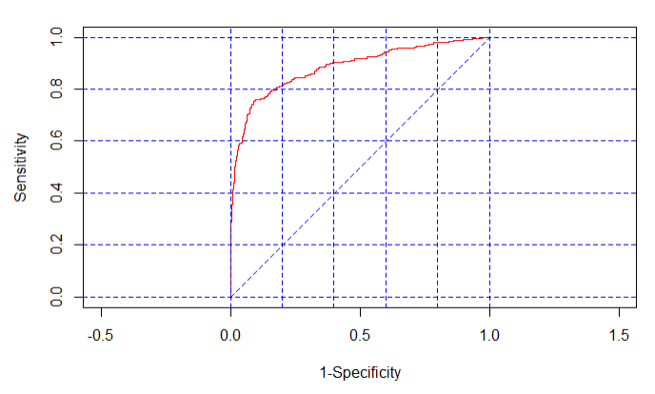
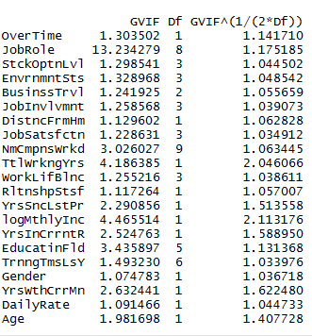
Forward Selection: VIF and ROC Curve
After removing Job Role from the model the VIF changed drastically for all other variables
Receiver Operating Characteristic (ROC) summarizes the model’s performance by evaluating the trade offs between true positive rate (sensitivity) and false positive rate (1-specificity).
Area under the curve (AUC) is 88.46%, which means that the model is doing a good job at predicting Attrition from the data.

Slide 32
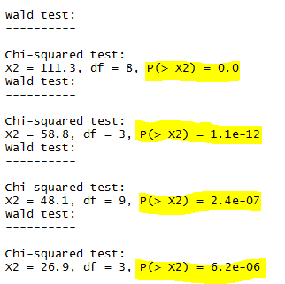
Chi-square test of Independence
We do see that all 4 explanatory variables identified by the model are statistically significant.
Job Role
Stock Option Level
# of Companies worked
Environment Satisfaction

Slide 33
Deviance For Two Models (Forward AndStepwise)
Deviance
Forward – 764.3014
Stepwise – 764.3014
AIC Values
Forward - 888.3014
Stepwise - 888.3014

Slide 34
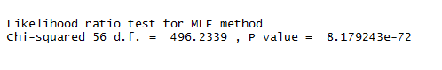
Goodness of Fit Test : Forward and Reduced (Intercept) Model and Pseudo R^2
Null Hypothesis is that reduced model is better than the forward2 model
Reject null hypothesis as p-value < 0.05
Pseudo R^2 is
0.38 i.e. 38% (McFadden's R squared)

Slide 35
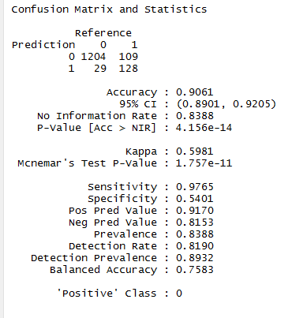
Classification: FORWARD 2 Model
Accuracy of Prediction – 90%
Columns are actuals
while rows are
predicted.

Slide 36
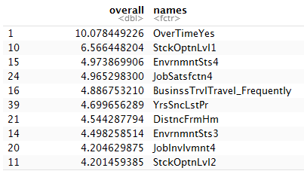
3 Best Predictors Of The Model
3 Best Predictors for the model:
OverTime (ref=“No”)
Stock Option Level
Environment Satisfaction.

Slide 37
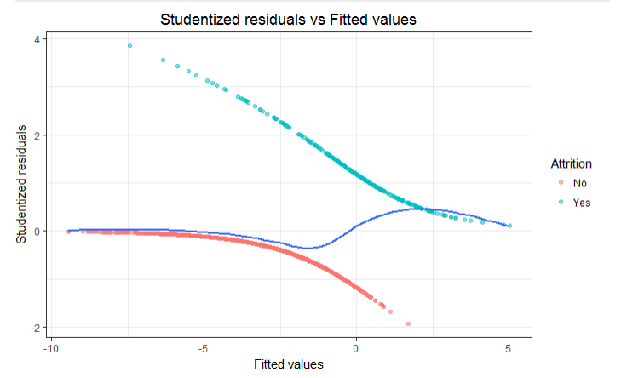
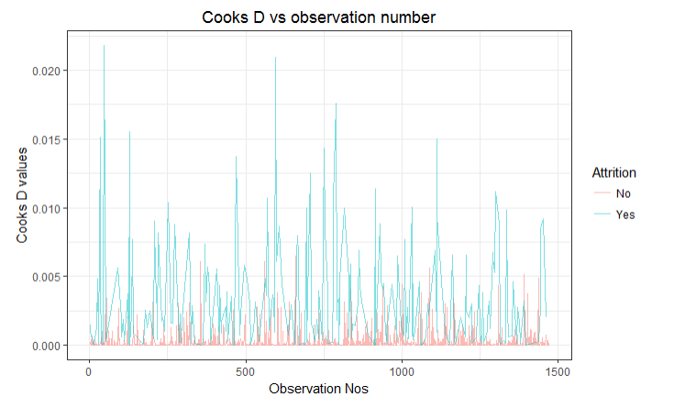
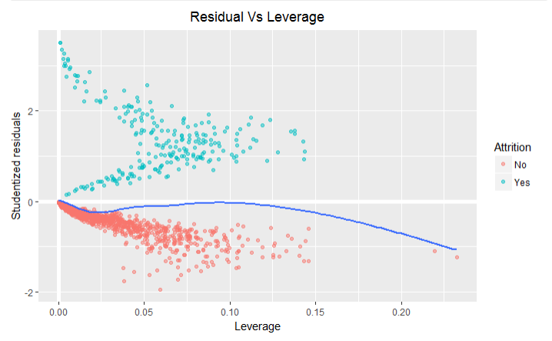

Studentized residuals vs Fitted values

Slide 38

Cooks D distance vs Leverage
Based on the below chart we do not see any influential observations or outliers so we have included all the data. Cook’s D is around 0.025 and the leverage is less than 0.3.

Slide 39

Summary – Need to change Copy forward2 model fit equation
According to our analysis, check the likelihood ratio test of the nothing model with the stepwise and forward selection models, the best model is FORWARD 2 Model as follows
$$pred Attribtion=9.03−0.0265Age+2.106BusinssTrvlTravel_{Frequency}+1.09BusinssTrvlTravel_{Rarely}−0.000389DailyRate+0.0518DistncFrmHm−0.399EduFldLifeSci+0.0785EduFldMktng−0.557EduFldMedical−0.435EduFldOther+0.563EduFldTechDgr−1.112EnvrnmntSts2−1.193EnvrnmntSts3−1.317EnvrnmntSts4+0.435GenderMale−1.154JobInvlvmnt2−1.412JobInvlvmnt3−2.023JobInvlvmnt4+1.023JobRoleHR+1.085JobRoleLabTecn+0.739JobRoleManager+0.2178JobRoleManufacturing_{Director}−0.9076JobRoleRschDirector−0.00066JobRoleRschScientist+1.0297JobRoleSalesExecutive+1.662JobRoleSalesRep−0.663JobSatsfctn2−0.6897JobSatsfctn3−1.338JobSatsfctn4+0.6777NmCmpnsWrkd1+0.559NmCmpnsWrkd2+0.028NmCmpnsWrkd3+0.654NmCmpnsWrkd4+1.525NmCmpnsWrkd5+1.412NmCmpnsWrkd6+1.733NmCmpnsWrkd7+0.885NmCmpnsWrkd8+1.985NmCmpnsWrkd9+2.094OverTimeYes−0.307RltnshpStsf−1.426StckOptnLvl1−1.557StckOptnLvl2−0.696StckOptnLvl3−0.016TtlWrkngYrs−1.142TrnngTmsLsY1−1.311TrnngTmsLsY2−1.635TrnngTmsLsY3−1.045TrnngTmsLsY4−1.744TrnngTmsLsY5−2.057TrnngTmsLsY6−0.995WorkLifBlnc2−1.498WorkLifBlnc3−1.02WorkLifBlnc4−0.089YrsInCrrntR+0.203YrsSncLstPr−0.113YrsWithCrrMn−0.712logMthlyInc$$

Slide 40
Insights and Conclusions
From the exploratory data analysis, we can derive the following conclusions:
Data visualization allows us to identify the variables where subjects show distinct rates of attrition:
Age, entry-level job role, low income, and marital status (single), which are correlated with being sales representatives.
People that had to stock options, worked extra time, and changed jobs frequently
People who are dissatisfied with their job, environment and relationships
Younger people in entry-level jobs on the field (sales representatives) have the highest attrition.
Beyond entry-level jobs, there is groups of people whose attrition might be explained by the desire to grow in other companies (aspiring managers and seasoned managers that had hit a “ceiling”.
Satisfaction in the job, in its different manifestations, is also an important determinant of attrition.
From the regression analysis, we can derive the following conclusions:
The most important factors that contribute to attrition are: Working Overtime, Stock Option Level and Environment Satisfaction.
The proposed model does a good job at predicting attrition, with an accuracy close to 89%.
We found that the predictive model is relatively simple, because there are many variables in the dataset that are closely related. Most of the predicting power comes from just a few variables.

Slide 41
Recommendations
Take into account your industry and what is going on in the market. Decide what your attrition benchmark is, and set targets for improvement.
Segment your employees and invest strategically: in those groups with high attrition risk, identify those who can provide a large lifetime value, and aggressively invest in them. According to our analysis, some groups can be described as:
Talented, young, single sales representatives
Aspiring managers eager to make it to the next level
Mid-level managers that value status and work meaning apart from money
Redesign overtime in a way that it becomes less taxing for employees and where monetary incentives can help retain them
Understand location patterns of single employees and those with families, to prevent distance from home becoming a factor that increases attrition levels. Explore options to work from home.
Screen out people with a history of changing jobs very frequently, because no matter what other actions you take, there’s going to be a group of people more likely to leave the company.

Slide 42
Attrition should be a concern for companies, and models of employee retainment should be explored by management.
Examples in the dataset:
People intrinsically more prone to leave a job
Young level-1 or level-2 employees that can be developed
Examples in the dataset:
Aspiring managers of mid-level managers
Highly knowledgeable employees with several years in the company
Divest?
Aggressively retain
Low value.
High Attrition Risk
High value.
High Attrition Risk
Attrition Risk
Grow-up
Maintain
Low value.
Low Attrition Risk
High value.
Low Attrition Risk
Employee lifetime value

Slide 43
Improvements
Get a better measurement of job performance into the data. The question: “are the worst-performing employees being effectively separated from the company?” can’t be answered
Measure several periods of time
Check test of independence for all the variables
Run contrasts to check the statistical significance of all categorical variables

